Slide 1
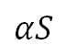
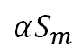
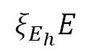
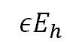
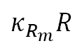
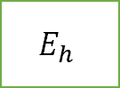
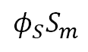
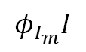
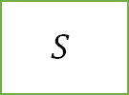
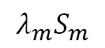
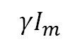
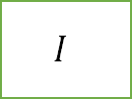
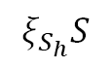
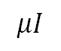
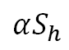
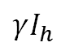
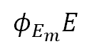
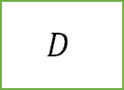
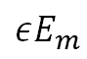
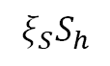
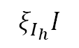
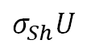
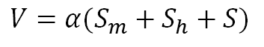
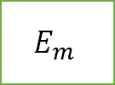
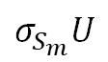
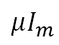
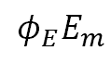

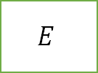
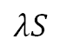
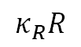
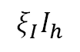
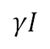
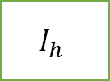
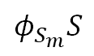
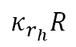
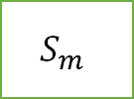
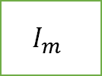
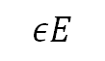
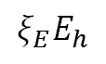
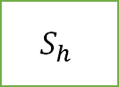
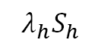
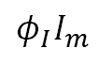
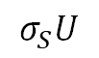
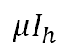
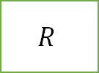
$$κ_{r_{h}}R$$
$$S_{h}$$
$$λ_{h}S_{h}$$
$$E_{h}$$
$$εE_{h}$$
$$I_{h}$$
$$σ_{Sh}U$$
$$ξ_{S}S_{h}$$
$$ξ_{E}E_{h}$$
$$μI_{h}$$
$$ξ_{E_{h}}E$$
$$ξ_{I_{h}}I$$
$$ξ_{I}I_{h}$$
$$ξ_{S_{h}}S$$
$$κ_{R}R$$
$$αS_{h}$$
$$γI_{h}$$
$$σ_{S}U$$
$$λS$$
$$εE$$
$$U$$
$$S$$
$$E$$
$$I$$
$$μI$$
$$αS$$
$$D$$
$$γI$$
$$φ_{S}S_{m}$$
$$φ_{S_{m}}S$$
$$φ_{E}E_{m}$$
$$φ_{E_{m}}E$$
$$φ_{I}I_{m}$$
$$φ_{I_{m}}I$$
$$σ_{S_{m}}U$$
$$αS_{m}$$
$$R$$
$$μI_{m}$$
$$S_{m}$$
$$E_{m}$$
$$I_{m}$$
$$γI_{m}$$
$$λ_{m}S_{m}$$
$$εE_{m}$$
$$V=α(S_{m}+S_{h}+S)$$
$$κ_{R_{m}}R$$

Slide 2
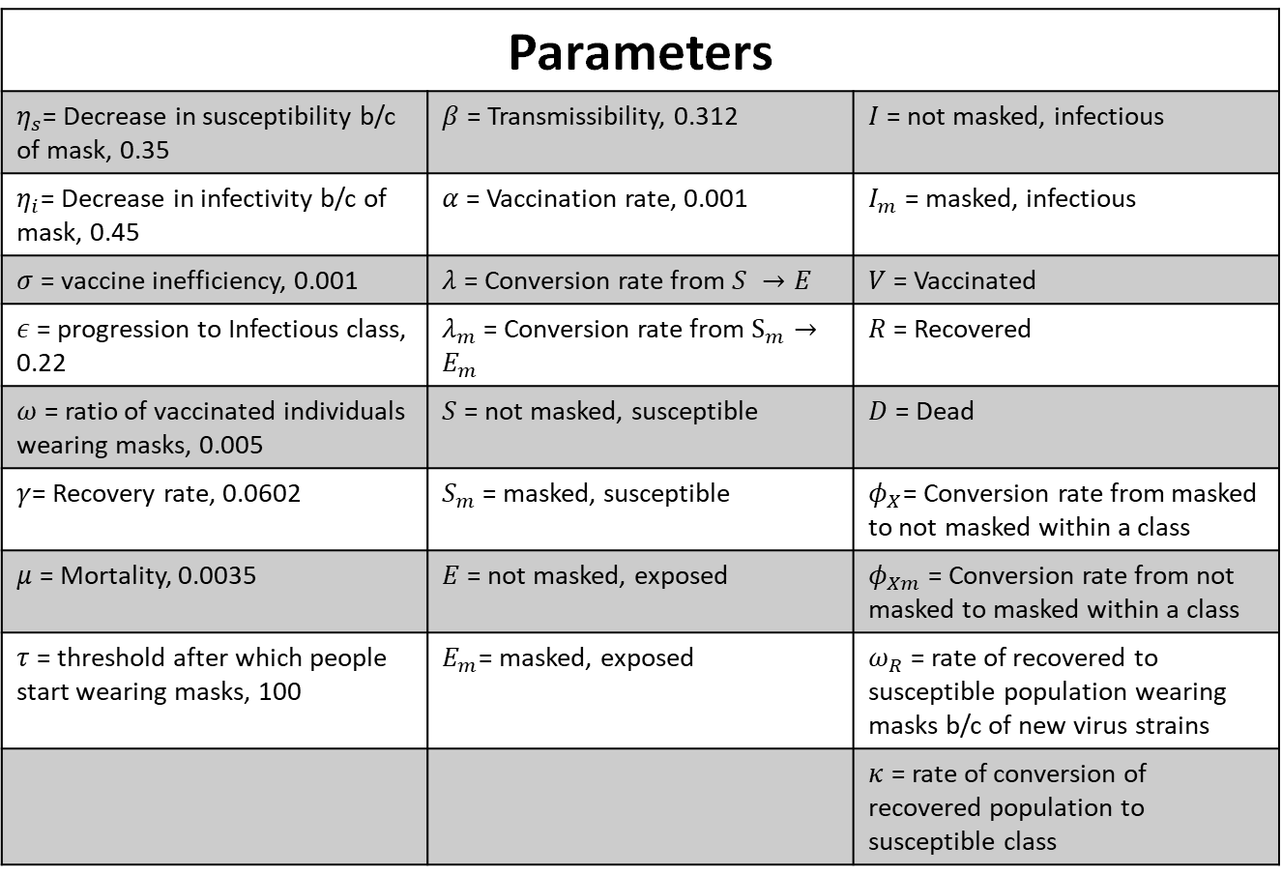
Parameter values from paper
Parameters
$η_{s}$= Decrease in susceptibility b/c of mask, 0.35 | $β$ = Transmissibility, 0.312 | $I$ = not masked, infectious
$η_{i}$= Decrease in infectivity b/c of mask, 0.45 | $α$ = Vaccination rate, 0.001 | $I_{m}$ = masked, infectious
$σ$ = vaccine inefficiency, 0.001 | $λ$ = Conversion rate from $S →E$ | $V$ = Vaccinated
$ε$ = progression to Infectious class, 0.22 | $λ_{m}$ = Conversion rate from $S_{m}→E_{m}$ | $R$ = Recovered
$ω$ = ratio of vaccinated individuals wearing masks, 0.005 | $S$ = not masked, susceptible | $D$ = Dead
$γ$= Recovery rate, 0.0602 | $S_{m}$ = masked, susceptible | $φ_{X}$= Conversion rate from masked to not masked within a class
$μ$ = Mortality, 0.0035 | $E$ = not masked, exposed | $φ_{Xm}$ = Conversion rate from not masked to masked within a class
$τ$ = threshold after which people start wearing masks, 100 | $E_{m}$= masked, exposed | $ω_{R}$ = rate of recovered to susceptible population wearing masks b/c of new virus strains
 |  | $κ$ = rate of conversion of recovered population to susceptible class

Slide 3
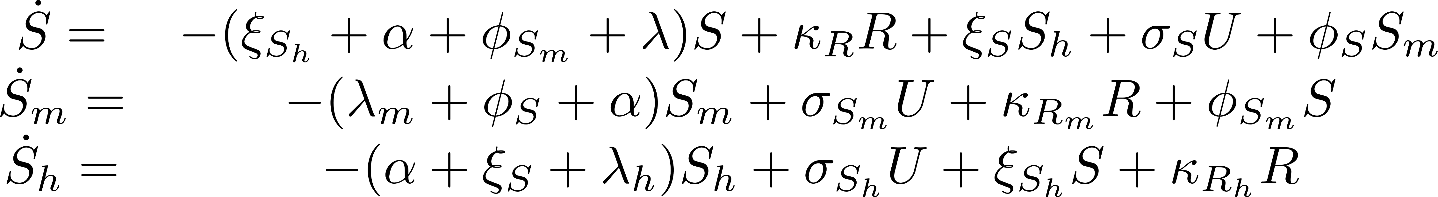
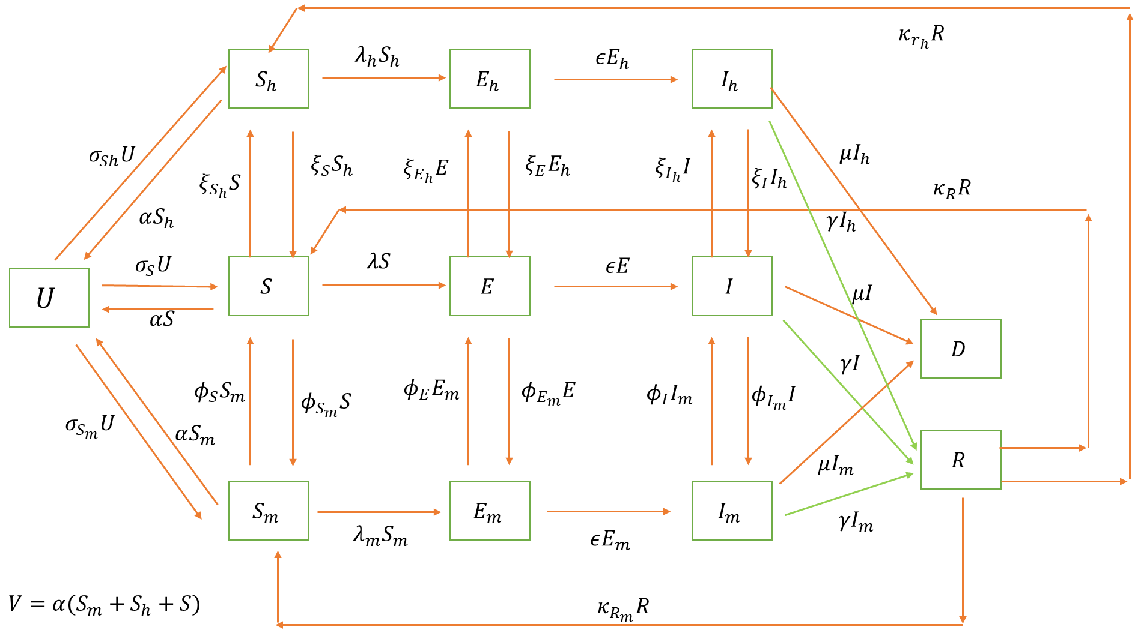
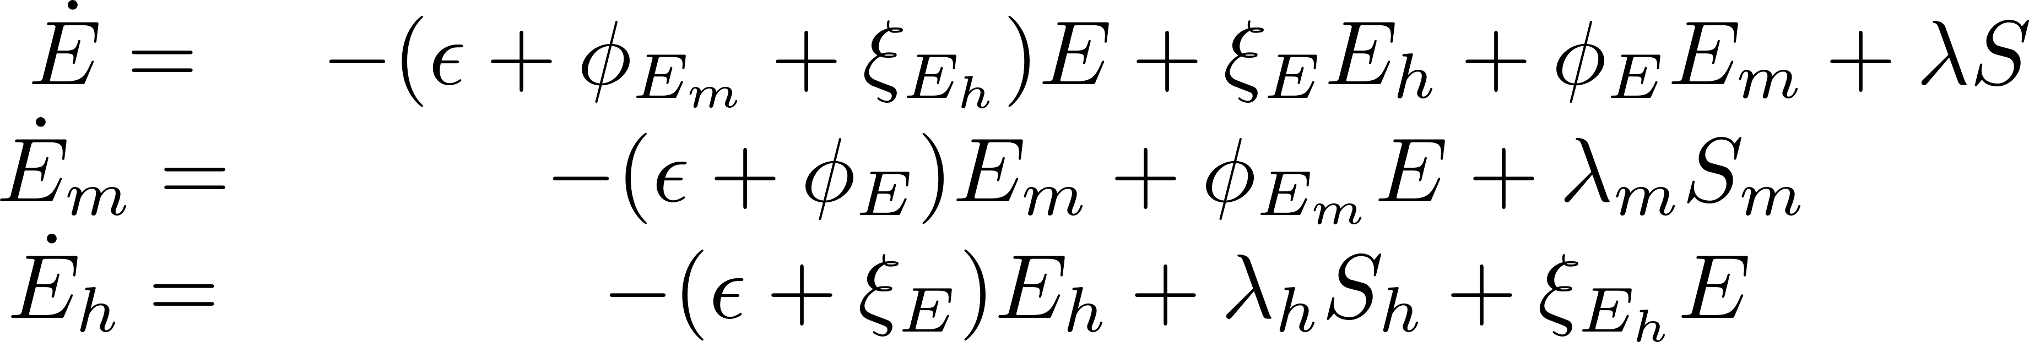
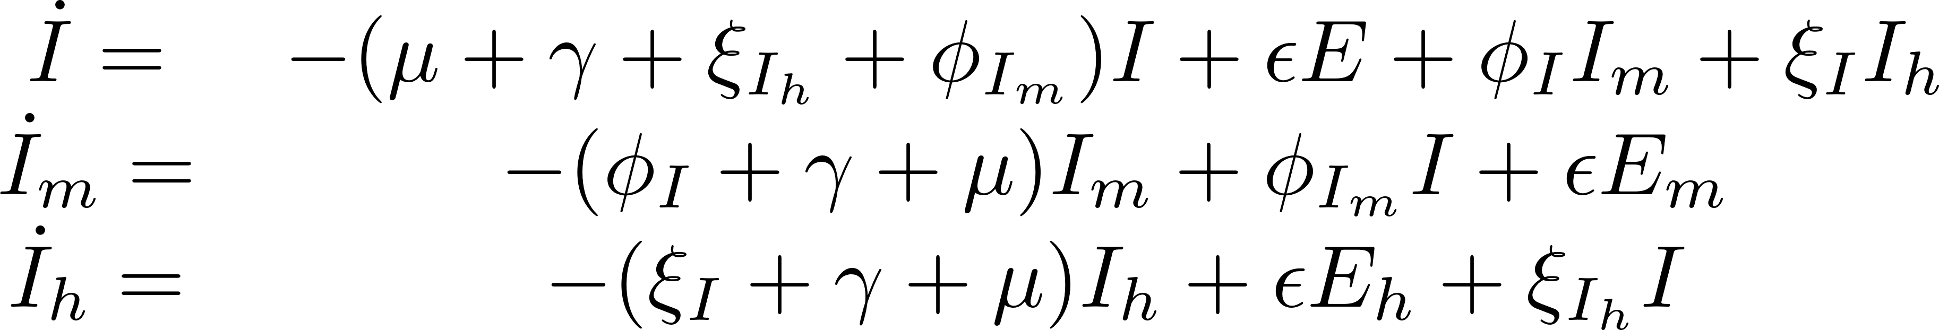






- Tune able Parameters

Slide 4













Objective function
$$O=w_{D}\sqrt{\sum_{t}{{\left(\hat{D\left(t\right)}−D\left(t\right)\right)}^{2}}}+w_{I}\sqrt{\sum_{t}{{\left(\hat{I\left(t\right)}−I\left(t\right)\right)}^{2}}}{+ w}_{U}\sqrt{\sum_{t}{{\left(\hat{V\left(t\right)}−V(t)\right)}^{2}}}{+ w}_{H}\sqrt{\sum_{t}{{\left(\hat{H\left(t\right)}−H\left(t\right)\right)}^{2}}}{+ w}_{M}\sqrt{\sum_{t}{{\left(\hat{M\left(t\right)}−M\left(t\right)\right)}^{2}}}$$
$$V\left(t\right)= \sum_{τ=0}^{t}{U(t)}$$
$$w_{D}=0.35, w_{I}=0.1, w_{U}=0.35, w_{H}=0.1,w_{M}=0.1$$
$$H={−(S}_{h}+E_{h}+I_{h})/(S_{h}+E_{h}+I_{h}+S_{m}+E_{m}+I_{m}+S+E+I+U+D +R)$$
$$M={(S}_{m}+E_{m}+I_{m})/(S_{h}+E_{h}+I_{h}+S_{m}+E_{m}+I_{m}+S+E+I+U+D +R)$$
Initial Conditions
$$S_{0}=9.7E6 −24$$
$$I_{0}=24$$
Other parameters start from 0
$$0.1≤φ_{1},φ_{2},ξ_{1},ξ_{2}≤1$$
$$0.01≤σ_{S}, σ_{S_{m}}, σ_{S_{h}},κ_{R_{h}},κ_{R},κ_{R_{m}}≤1$$
$$0.2≤β≤0.4$$
$$0.01≤γ≤0.3$$
$$0.001≤μ≤0.01$$
$$0.1≤η_{s_{m}}≤1.0$$
$$0.1≤η_{I_{m}}≤1.0$$
$$0.1≤ε≤1.0$$
$$0.1≤η_{S_{h}}≤1.0$$
$$0.1≤η_{I_{h}}≤1.0$$

Slide 5

SEI mean plots with standard deviation

Slide 6


Slide 7

TEs on different infection routes

Slide 9


Slide 10
Appendix

Slide 11


Slide 12


Slide 13


Slide 14



Parameters within limits as described in previous slides
$$Initial$$
$$Δ$$
omicron

Slide 15


Slide 16


Slide 17


Slide 18




- Tune able Parameters

Slide 19






Objective function
$$O=w_{D}\sqrt{\sum_{t}{{\left(\hat{D\left(t\right)}−D\left(t\right)\right)}^{2}}}+w_{I}\sqrt{\sum_{t}{{\left(\hat{I\left(t\right)}−I\left(t\right)\right)}^{2}}}{+ w}_{U}\sqrt{\sum_{t}{{\left(\hat{V\left(t\right)}−V(t)\right)}^{2}}}{+ w}_{H}\sqrt{\sum_{t}{{\left(\hat{H\left(t\right)}−H\left(t\right)\right)}^{2}}}{+ w}_{M}\sqrt{\sum_{t}{{\left(\hat{M\left(t\right)}−M\left(t\right)\right)}^{2}}}$$
$$V\left(t\right)= \sum_{τ=0}^{t}{U(t)}$$
$$w_{D}=0.35, w_{I}=0.1, w_{U}=0.35, w_{H}=0.1,w_{M}=0.1$$
$$H={−(S}_{h}+E_{h}+I_{h})/(S_{h}+E_{h}+I_{h}+S_{m}+E_{m}+I_{m}+S+E+I+U+D +R)$$
$$M={(S}_{m}+E_{m}+I_{m})/(S_{h}+E_{h}+I_{h}+S_{m}+E_{m}+I_{m}+S+E+I+U+D +R)$$
Initial Conditions
$$S_{0}=9.7E6 −24$$
$$I_{0}=24$$
Other parameters start from 0
$$0.01≤ ω_{1}, ω_{2}, θ_{1}, θ_{2},ζ_{1}, ζ_{2}, a_{1},a_{2},b_{1},b_{2}≤10$$
$$0.01≤σ_{S_{max}}, σ_{{S_{m}}_{max}}, σ_{S_{h_{max}}}, c, η_{i}≤1$$
$$300≤t_{0}≤1000$$
$$0.2≤β≤0.4$$
$$0.01≤γ≤0.3$$
$$0.001≤μ≤0.01$$
$$0.01≤η_{s_{m}}≤1.0$$
$$0.01≤η_{I_{m}}≤1.0$$
$$0.1≤ε≤0.3$$
$$0.01≤η_{S_{h}}≤1.0$$
$$0.01≤η_{I_{h}}≤1.0$$

Slide 20


Slide 21

Dry-Run with new weights

Slide 22

Death Fit

Slide 23

Vaccination fit

Slide 24

Death and Vaccination Fit

Slide 25

Multiple Fit

Slide 26

Multiple Fit

Slide 27

Multiple Fit

Slide 28

Fit
Fit with 1000 days

Slide 29

Piecewise
\kappa -2
\beta -3
\mu – 3
t1 of beta 1 is same as t1 of mu1
Lower limits of t-s to new variants
Try different objective functions including max and weighted and pareto etc.

Slide 30

Multiple Fit

Slide 31

Infectious Fit

Slide 32


